Slide 1
[Insert date here]
Notes:
Hello/ welcome
[Personal introduction – add name to slide if required]
As the UK’s national laboratory for nuclear fission, NNL is harnessing nuclear science to help solve some of the world’s biggest challenges – from achieving deep decarbonisation to delivering lifesaving healthcare.
Let me tell you a little more about what we do and how – and why – we do it.

Slide 2
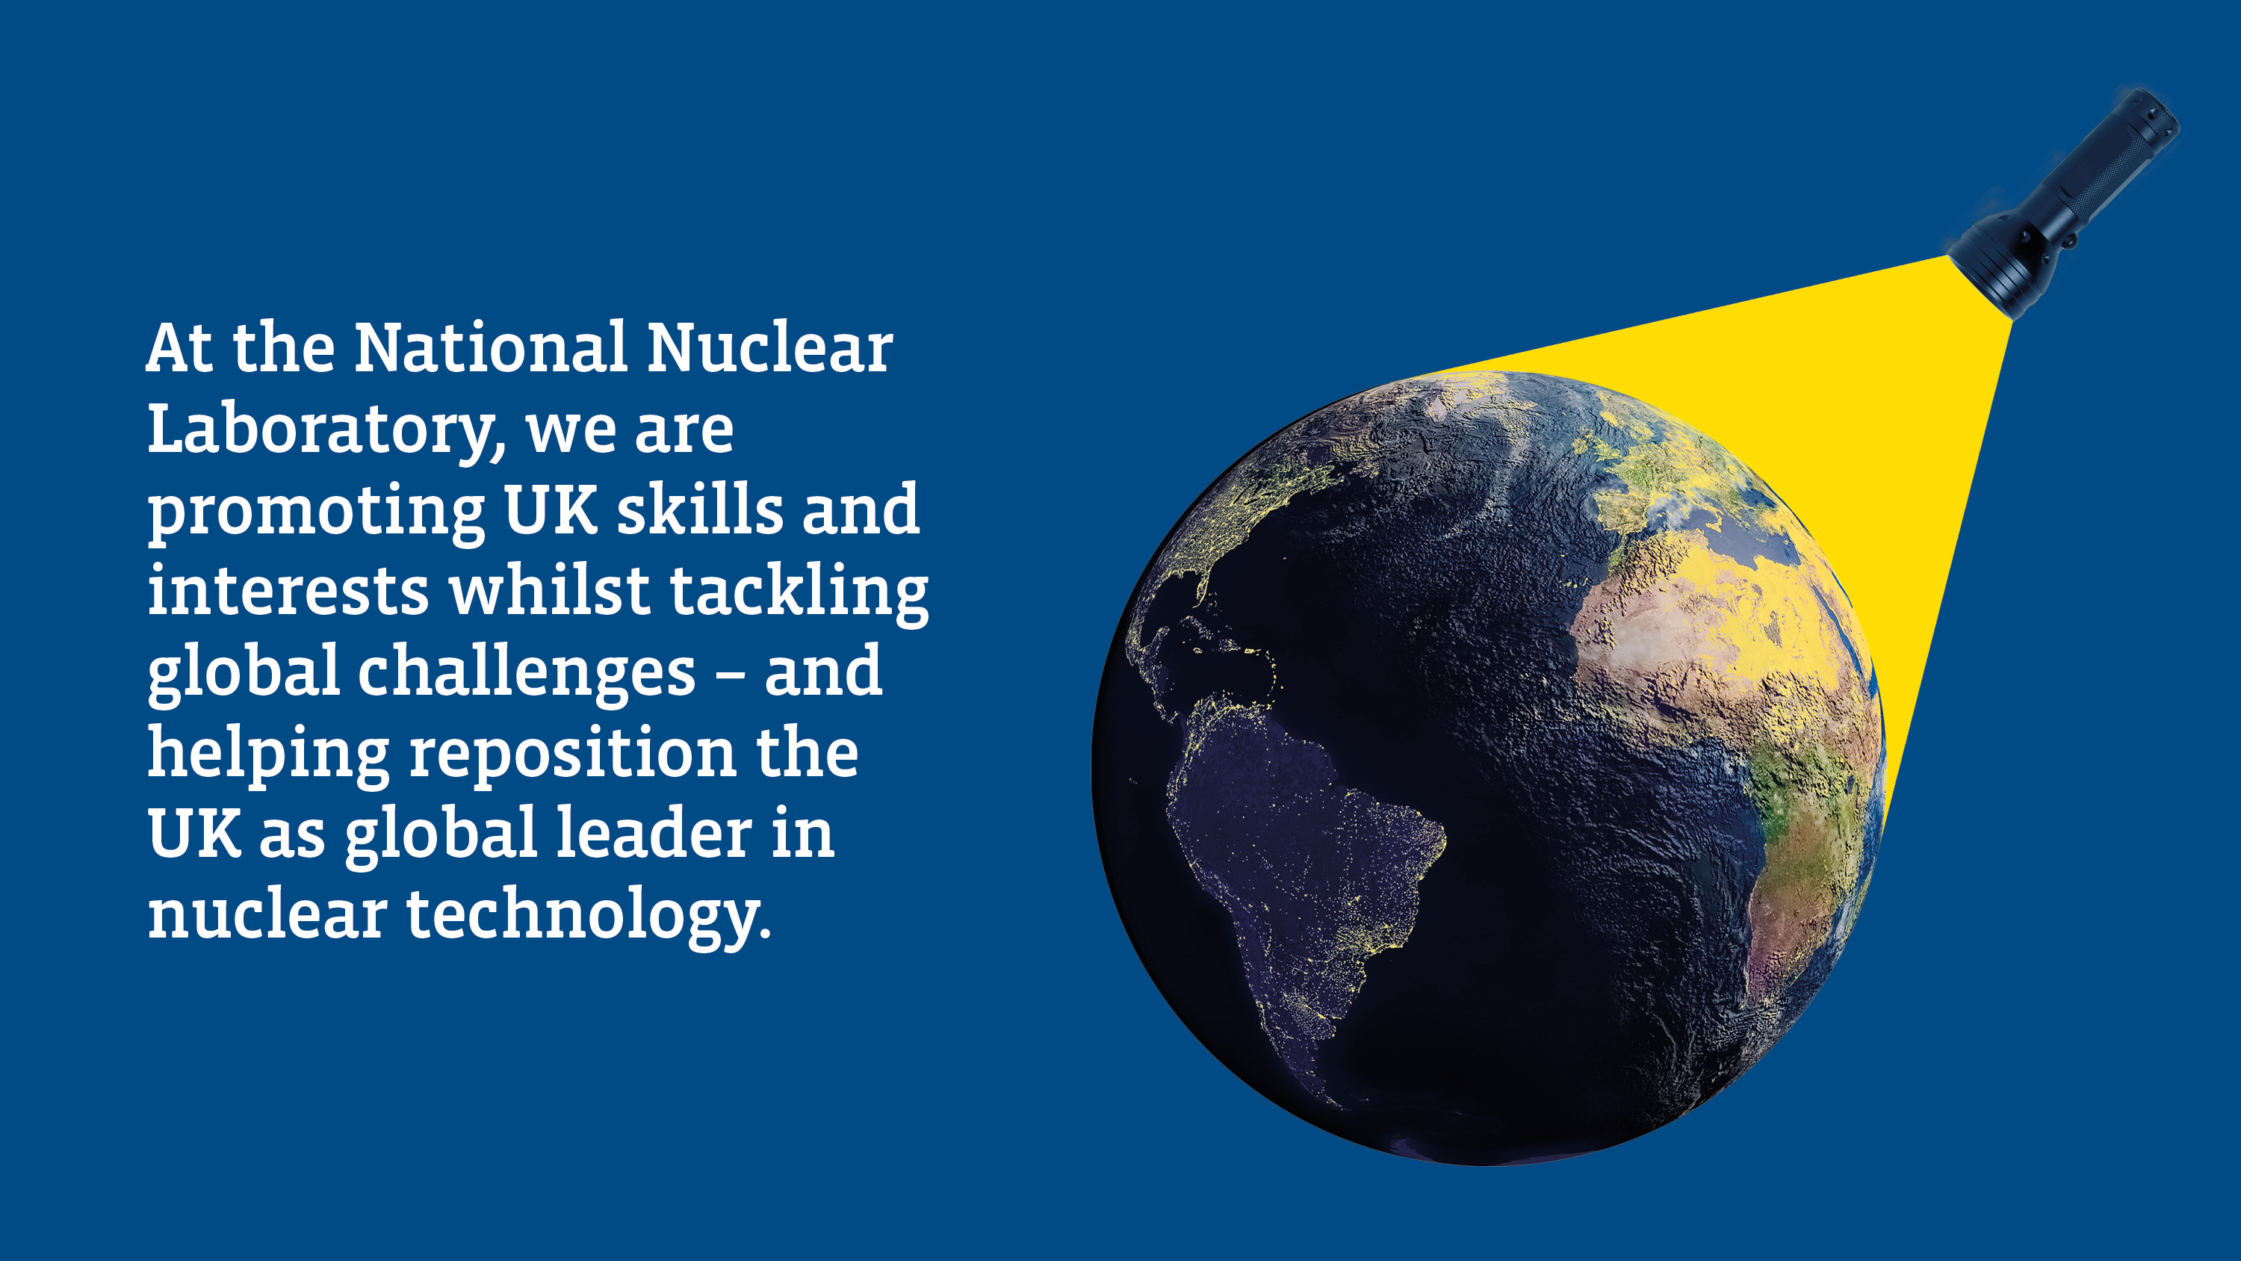
National Nuclear Laboratory
Notes:
(SLIDE 1 – FOCUS ON ENVIRONMENT)
In the UK and around the world, scale of the challenge ahead to reach net zero by 2050 cannot be overestimated.
With our roots as the research arm of British Nuclear Fuels Limited (BNFL), we combine the decades of expertise of sector veterans, whose science has been at the forefront of nuclear technology over the past 30 years, with an emerging generation of talented and idealistic scientists, engineers and professionals – all of whom are applying nuclear science to benefit society.
In doing so, we are promoting UK skills and interests whilst tackling global challenges – and helping reposition the UK as global leader in nuclear technology.

Slide 3
National Nuclear Laboratory
Notes:
(SLIDE 2 – POSITIVE OUTLOOK, ILLUSTRATION)
Alongside our customers and partners in government, academia and the supply chain, we are working to build a new clear future for the UK and for our planet.
By leveraging the UK’s rich nuclear heritage, we are addressing issues of critical national importance and supporting regional growth around the UK but particularly in the North West.

Slide 4
National Nuclear Laboratory
Notes:
(SLIDE 3 – 4 FOCUS AREAS + OPTIONAL FA SPECIFIC SLIDES)
We do work that is vital to protecting our planet and society.
Our ambition is to make a difference to people’s lives across four key focus areas:
Clean Energy, Environmental Restoration, Health & Nuclear Medicine and Security & Non-Proliferation.

Slide 5
National Nuclear Laboratory
Notes:
Clean Energy
Securing the UK’s place as a global leader in clean energy now and for the future, by developing and deploying advanced nuclear technologies

Slide 6
National Nuclear Laboratory
Notes:
Environmental Restoration
Driving a step change in the way legacy and future wastes are processed by applying innovative science and breakthrough technologies

Slide 7
National Nuclear Laboratory
Notes:
Health and Nuclear Medicine
Benefitting healthcare by advancing nuclear medicine in medical research and the treatment and diagnosis of conditions

Slide 8
National Nuclear Laboratory
Notes:
Security and Non-Proliferation
Facilitating the global deployment of new nuclear technologies by ensuring security and non-proliferation

Slide 9
National Nuclear Laboratory
Notes:
(SLIDE 4 – HERO SLIDE)
‘And here is how we are doing it.’

Slide 10
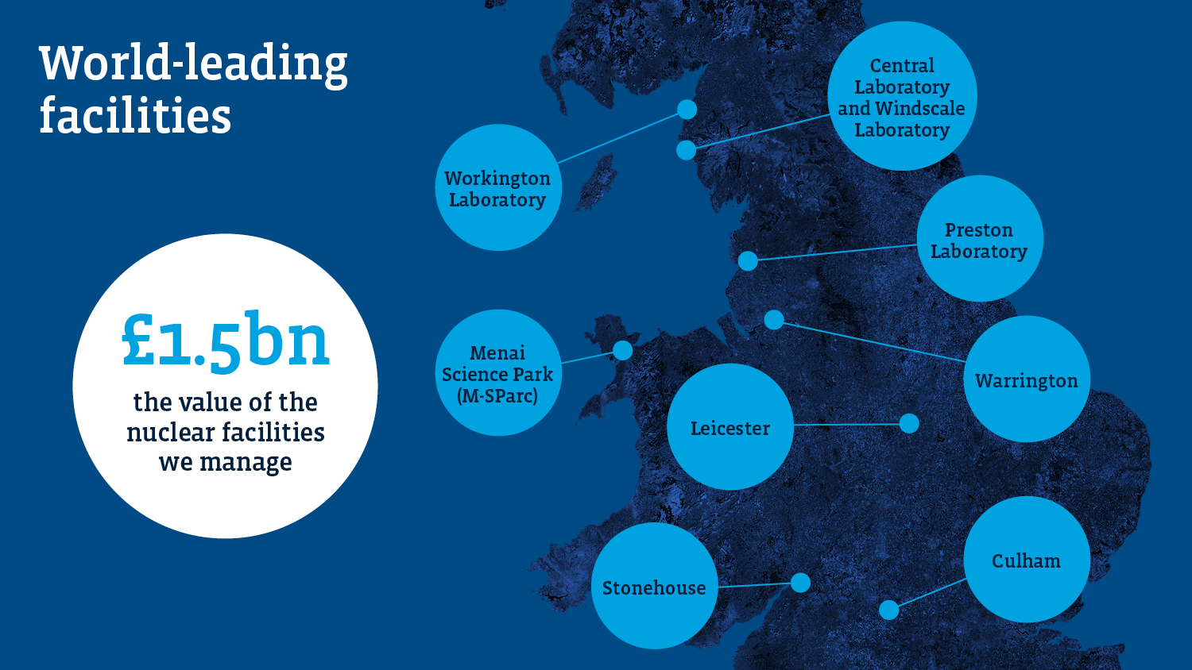
National Nuclear Laboratory
Notes:
(SLIDE 5 – VISUALISING SITES)
8 Sites – comprising four world-leading laboratories in the North West, three research sites around the UK and a base in Wales
We are custodians of a unique set of facilities and capabilities that enable ground-breaking nuclear research and development, generating £1.5bn in critical nuclear research and development infrastructure.
This includes four world-leading laboratories in the North West of England and a new base in Wales at Menai Science Park.
£1.5 billion
the value of the nuclear facilities we manage
In Seascale, Cumbria, at Sellafield, this includes:
Central Laboratory
NNL’s flagship, the most modern nuclear technology research facility in the world, and an asset to UK and global nuclear research and development
Windscale Laboratory
Unique in the UK, and vital to the nuclear industry, it works with operators to ensure the continued safe running of our nation’s nuclear reactors
In Workington, Cumbria, this includes:
Workington Laboratory
A large and flexible industrial space for developing technology and skills for the UK’s nuclear sector
In Preston, Lancashire, this includes:
Preston Laboratory at Springfields, Lancashire
A centre of excellence for the next generation of nuclear fuels and clean energy technology
NNL has a base at Menai Science Park (M-SParc) on Ynys Môn / Isle of Anglesey in Wales and operates three other research sites at Risley in Cheshire, Stonehouse in Gloucestershire and Culham in Oxfordshire.

Slide 11
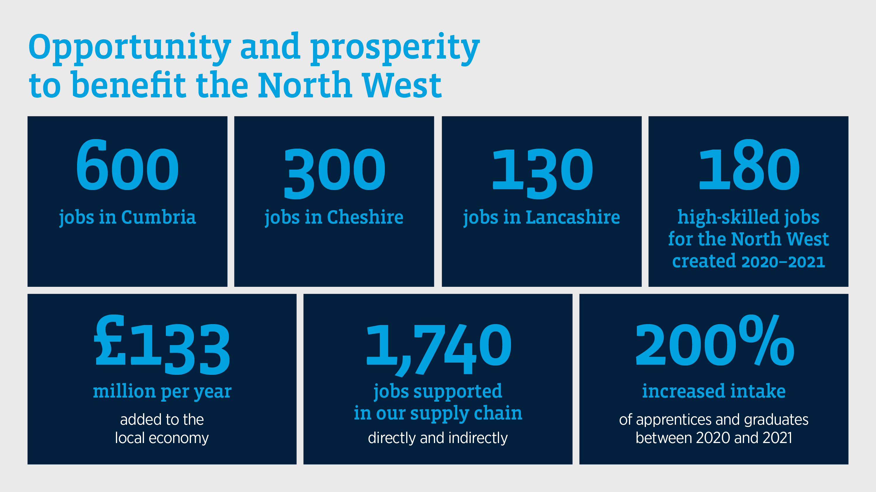
National Nuclear Laboratory
Notes:
(SLIDE 6 – OPPORTUNITY AND PROSPERITY)
Through our work, we bring high-skilled jobs, meaningful work and economic stimulus to our communities including the North West which is where all four of our laboratories are situated.
Not only have we expanded our programme for graduates and apprentices, but we are also successfully bringing in talented individuals from other sectors and industries. This cross-pollination of good ideas and effective practices is building our strength as an organisation and keeping us at the cutting-edge.
With a third of our work outsourced to other businesses and organisations, we are proud of our record in supporting the supply chain, sustaining jobs and helping our suppliers – many of which are in the UK’s small and medium sized businesses – to prepare for the opportunities ahead.

Slide 12
National Nuclear Laboratory
Notes:
(SLIDE 7 – ROLE + COLLABORATION)
Government owned – operationally independent
We have built a distinct identity as the UK’s technical authority on nuclear fission. Over decades, we have helped to sustain the UK’s nuclear skills and operational capacity and built our reputation both as a successful commercial organisation and a strategic national asset.
We operate on an autonomous commercial basis and have close and established relationships with our customers including BEIS, EDF, the Nuclear Decommissioning Authority, Sellafield Ltd, Rolls Royce and the MoD. Globally we have customers in the USA, Japan and Europe, and we work with overseas governments and utilities as well as other national laboratories. Our earnings from this work are reinvested to develop our science, innovation technology and our people.

Slide 13
National Nuclear Laboratory
Notes:
(SLIDE 8 – PEOPLE)
Our most important asset for future success is our people.
The most important asset for our future success is our people. We are fortunate to be gifted with some of the most creative and inspired scientific minds in our sector, in the world.
From award winning graduates to internationally acclaimed subject matter experts, everyone in our workforce is here to deliver environmentally and financially sustainable solutions to some of the world’s biggest challenges. And it is their skills, knowledge and enthusiasm that drives our work and fuels our purpose. People are the currency of the nuclear sector and we are determined to cultivate diversity, innovation and collaboration across all we do.
1,000+ people employed
10,000 – combined years of nuclear science expertise
400 scientists
150 PHDs – plus 100 PhDs sponsored across UK universities

Slide 14
National Nuclear Laboratory
Notes:
(SLIDE 9 – VALUES & BEHAVIOURS)
[Suggested optional slide for internal conversations only)
Our values and behaviours align our actions and act as our compass to guide our future.
To help us meet the opportunities of the new nuclear landscape, we are building a culture where everybody feels valued and can flourish, and a reputation as a home for stimulating, rewarding careers. People are the currency of the nuclear sector and we are determined to cultivate diversity, innovation and collaboration across all we do.

Slide 15
National Nuclear Laboratory
Notes:
(SLIDE 10 – SUSTAINABILITY)
We are driven by purpose
NNL is getting serious about its sustainability ambitions – we are a purpose-driven organisation and we see our role in delivering nuclear science to benefit society as being well executed through two key strands:
What we do as a National Lab, with four Focus Areas that harness nuclear science to benefit society
How we conduct our business and leverage our position as a platform for positive impact across the UN Sustainable Development Goals, ensuring we continue along the right path as a force for good in creating a safe, clean, inclusive and just society.
Our 3 Bold Ambitions:
We are committed to action and have now set three clear and compelling ambitions which we hope our people, suppliers and customers can all get behind
These are:
1. Environmental: We will achieve Net Zero, reduce our environmental impact by half and double our positive contributions to our natural systems, by 2030. We will provide our people with the freedom and flexibility to tread more lightly to reduce our collective impacts on, protect and enhance the natural environment.
2. Social: We will maximise the value we create for, and investments in, our people and in our communities
3. Economic: We will double the value to our stakeholders by 2030

Slide 16
National Nuclear Laboratory
Notes:
(SLIDE 11 – S&T)
Science and technology is, and always has been, the beating heart of NNL.
[Over decades, we have helped to sustain the UK’s nuclear skills and operational capacity and built our reputation both as a successful commercial organisation and a strategic national asset.] – (if not mentioned earlier)
Investing in scientific research and unleashing innovation is fundamental to our work as a national laboratory; allowing us to serve our customers, our partners and our nation better, and reposition the UK as a global leader in nuclear technology.
Our Science and Technology Agenda
is designed to ensure the UK has what it needs to underpin new and existing nuclear clean energy technologies, such as advanced reactors and hydrogen production. But it is also about breaking new ground and unlocking advancements across other parts of our lives and communities; keeping us at the cutting edge and giving our scientists and researchers the space to realise untapped opportunities.
Our Science and Technology Agenda is defined by three key pillars – Core Science, Innovation and Strategic Research – all of which are underpinned by Collaboration; a balanced portfolio that ensures we are addressing current as well as future needs.

Slide 17
National Nuclear Laboratory
Notes:
(SLIDE 12 – FINAL CLOSING HERO SLIDE)
So, whether it is securing the UK’s place as a global leader in clean energy, or delivering game-changing advances to healthcare, we are working to build a #NewClearFuture for the UK and for our planet

